Slide 1

-: PPT Presentation :-
By Kushanavo Rakshit, Swagato Chakraborty, Aditya Joshi
Summer Internship Project supervisor :- Prof Prasoon Kumar BM dept NIT Rourkela

Slide 2
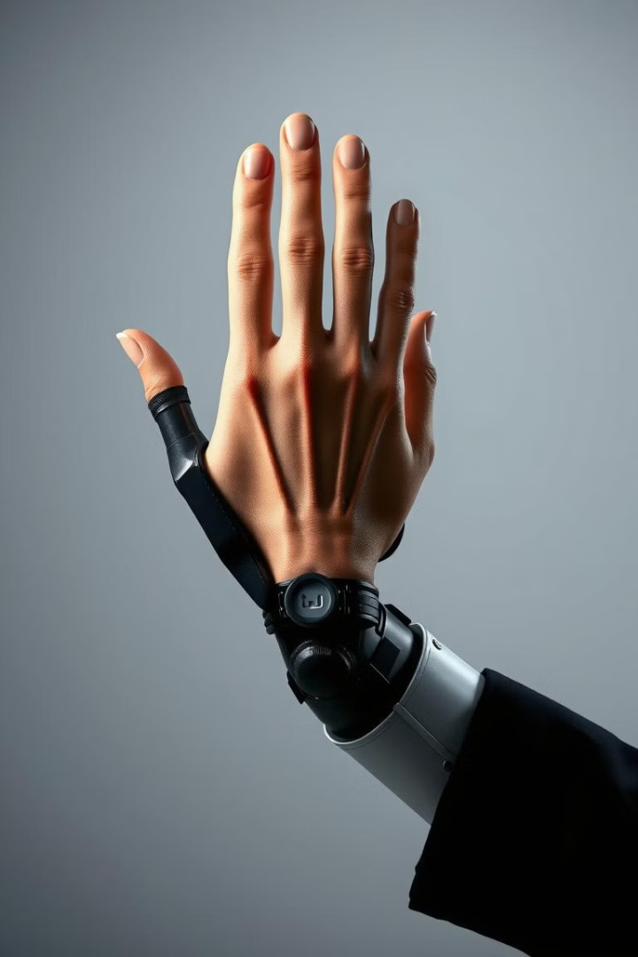
Project Topic
Design and development of a Bionic Arm using 4 channel EMG signals

Slide 3
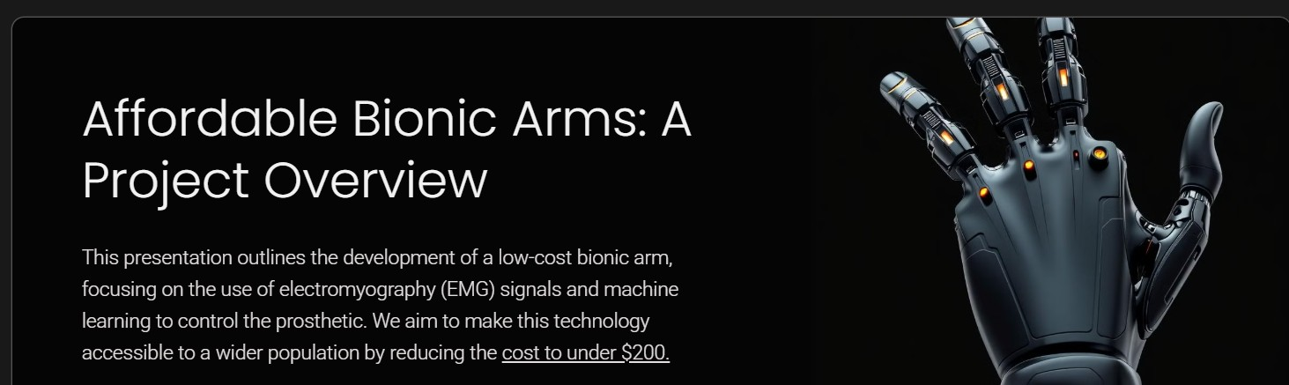
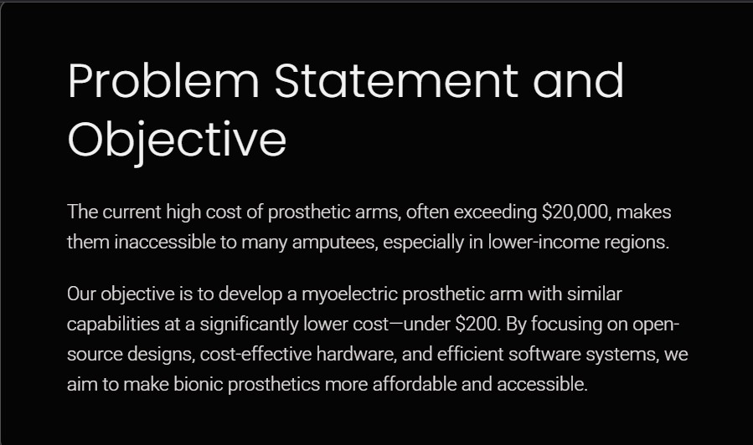

Slide 4
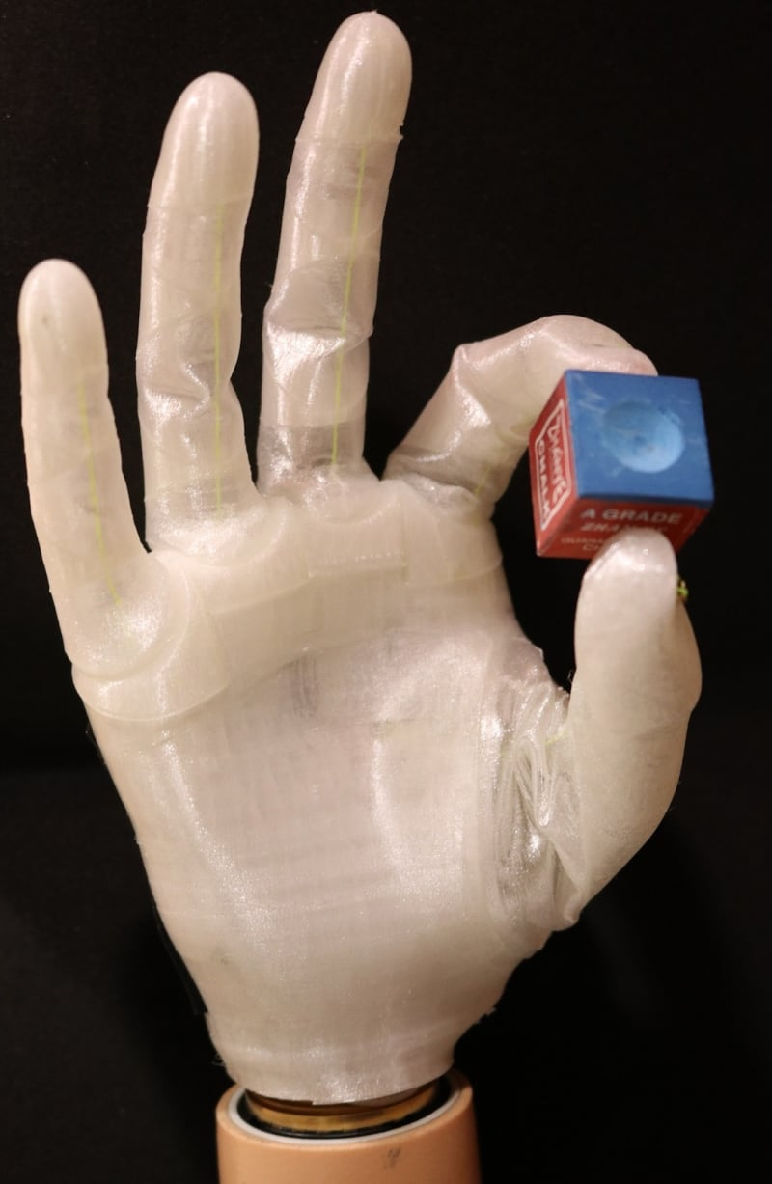
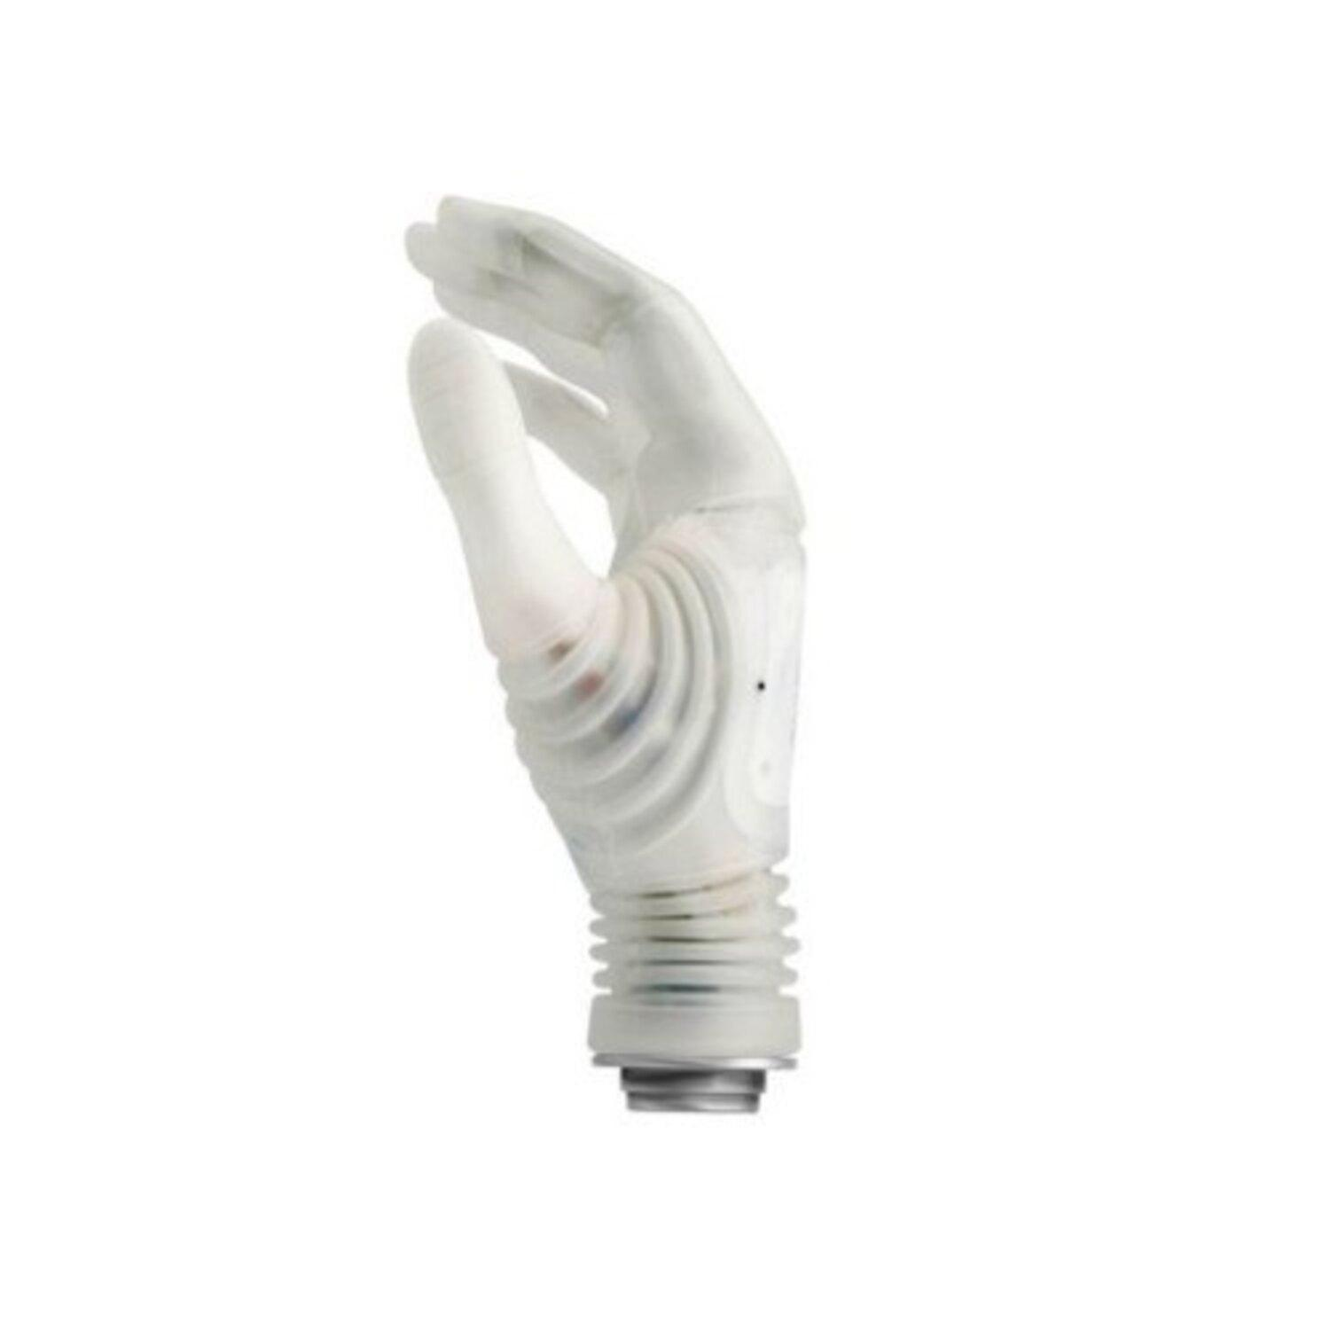
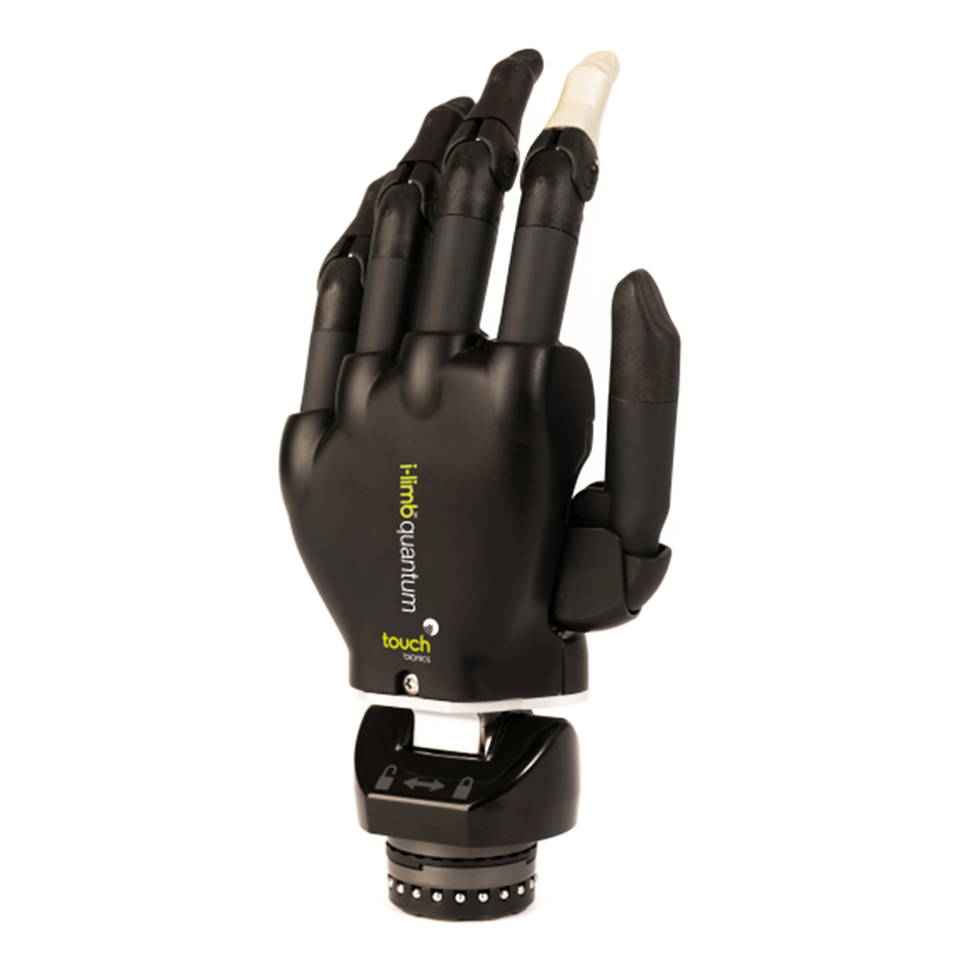
-: EXISTING SOLUTIONS AVAILABLE IN MARKET :-
(b) (c)
Fig. 2: Currently Available Myoelectric Prosthetics
(a) Michelangelo Hand by Otto Bock ($60,000) {Source: Ottobock US. "Michelangelo prosthetic hand."
(b) i-limb by Touch Bionics (₹1.5L) {Source: Designboom. "Touch Bionics app controlled prosthetic hand."
(c) X-limb ($200) {Source: ResearchGate. "X-Limb prosthetic hand with pinch grasp (left) and power grasp.”

Slide 5
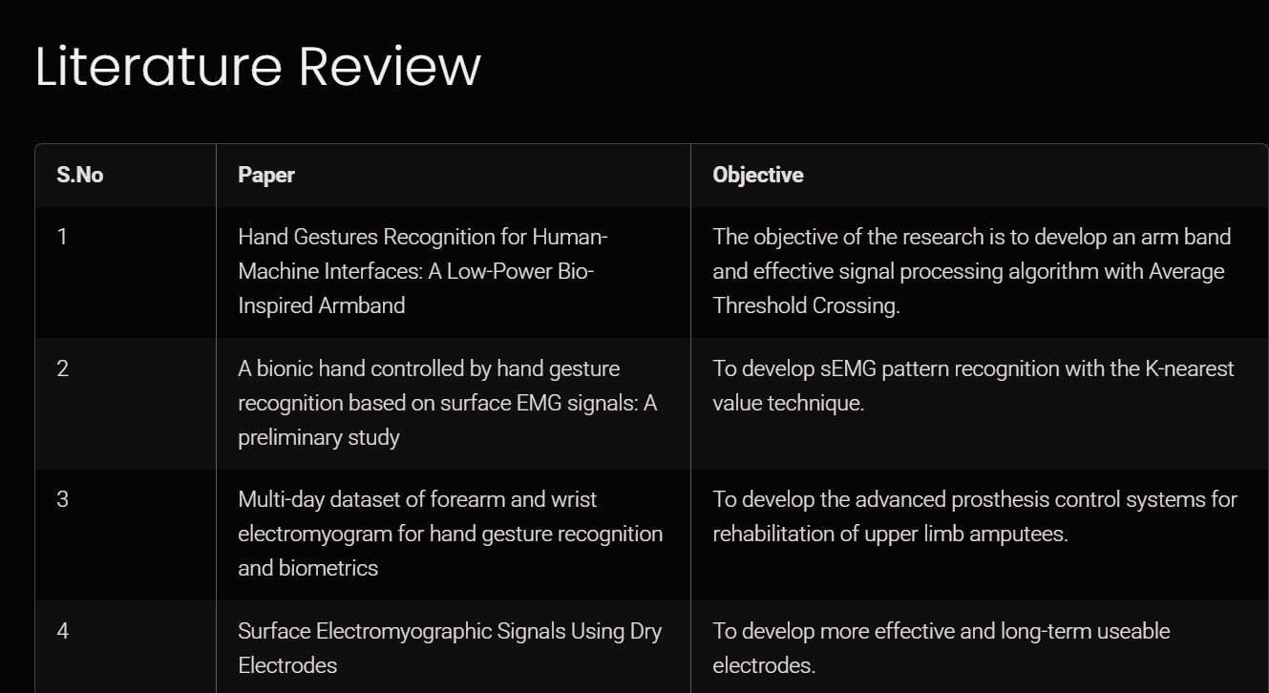

Slide 6
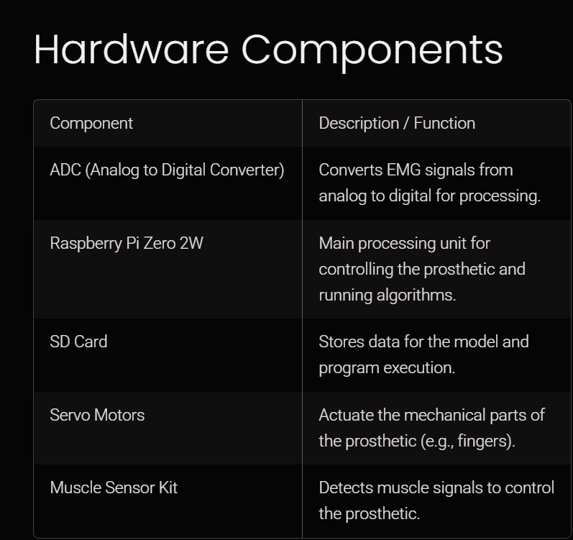
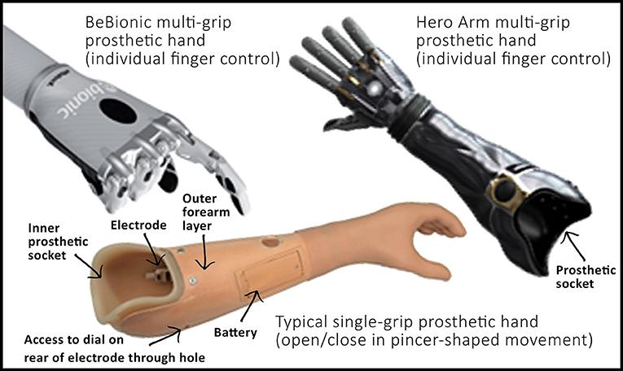

Slide 7
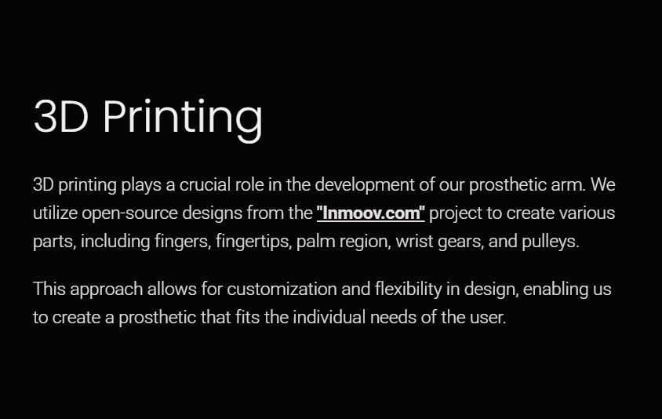
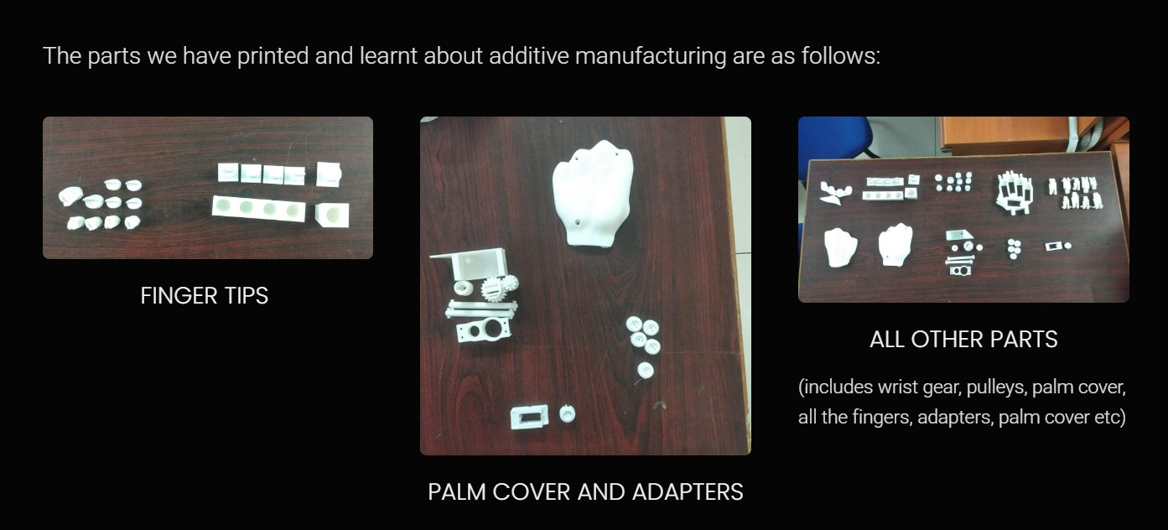
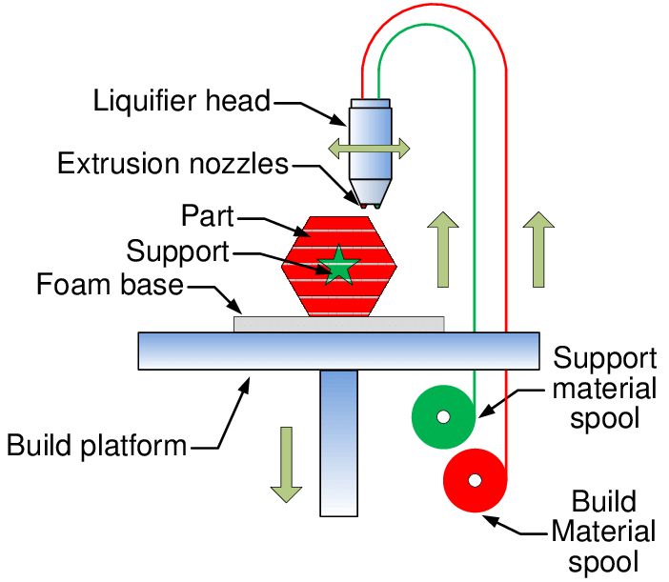

Slide 8
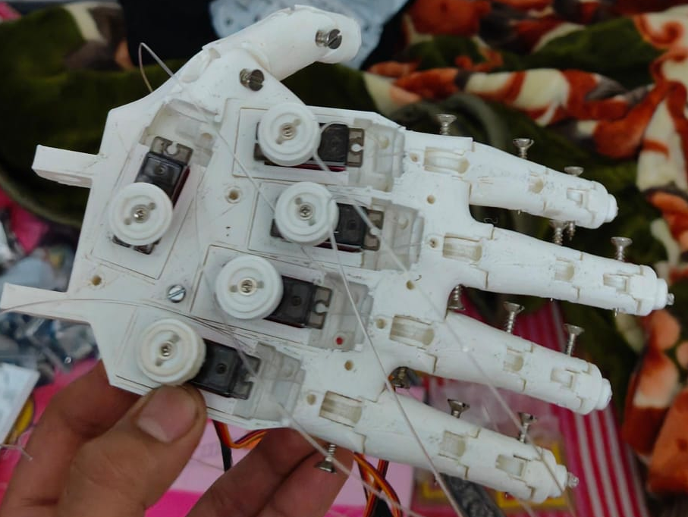
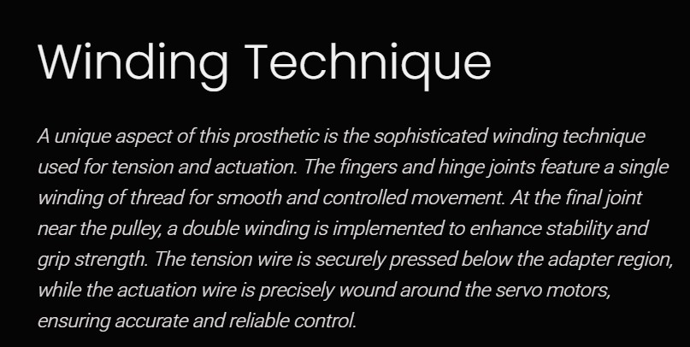
Methodology
1
EMG Signal Acquisition
Surface electrodes detect muscle signals.
2
Signal Processing
ADC digitizes data for computational analysis.
Noise filtering and signal extraction.
3D Printed Prosthetic Hand
3
ML Pipeline
1D Temporal CNN for feature extraction. MLP for servo angle prediction.
4
Actuation
Servo motors pull the nylon cables causing
the fingers to move

Slide 9
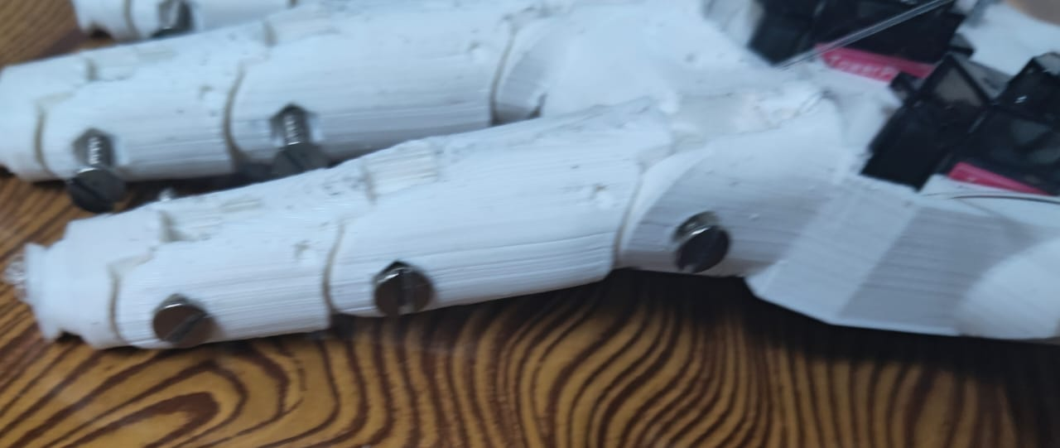
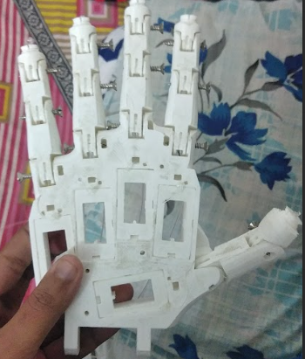
-: Materials Design And Principle :-
Cheap Materials :-
PLA for 3D-printed parts (lightweight, cost-effective). Nylon ropes for tension-based actuation, reducing motor requirements. Servo Motors and raspberry pi for actuation
The basic structure of the hand is 3D printed.
Despite limited functionality because of lack of strength due to our manufacturing process, a grip force of 21.5N has been achieved by similar methods
Tension in nylon ropes pulls fingers back to their extended position. Motors control contraction, reducing complexity and cost.
Similar setups have achieved finger flexion speed of 1.3sec, a minimum grasping cycles of 45,000 (while maintaining its original functionality)

Slide 10
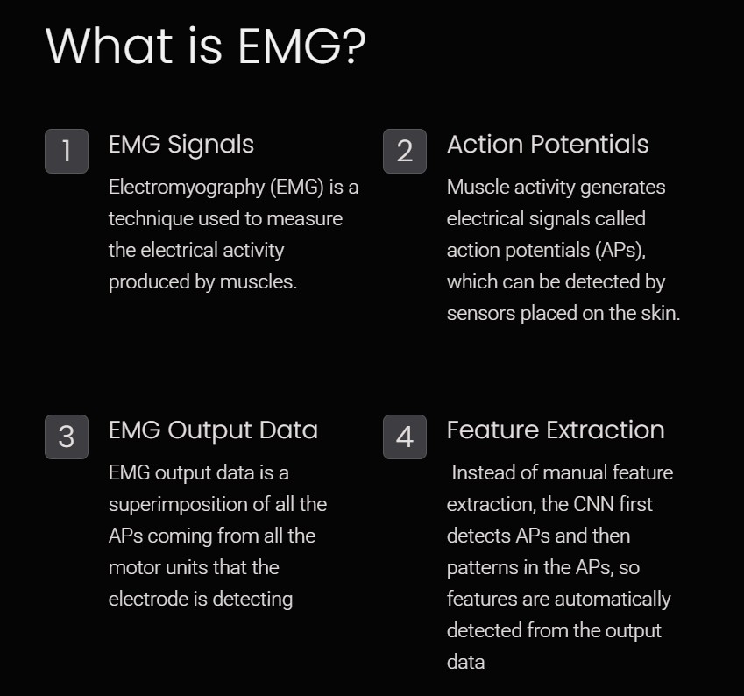
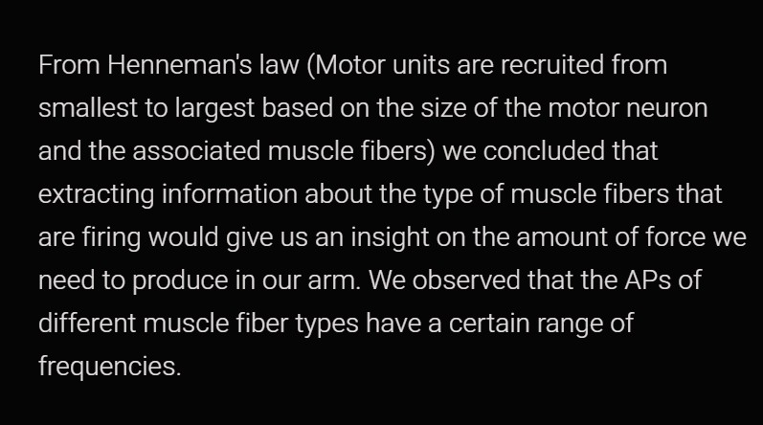

Slide 11
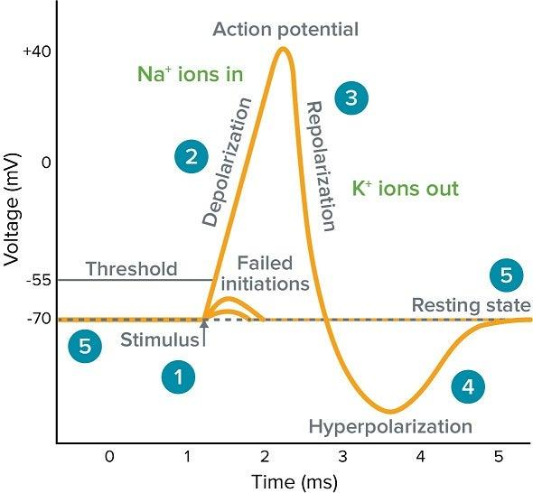
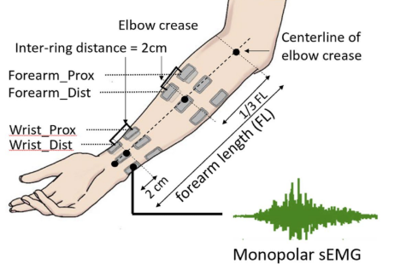
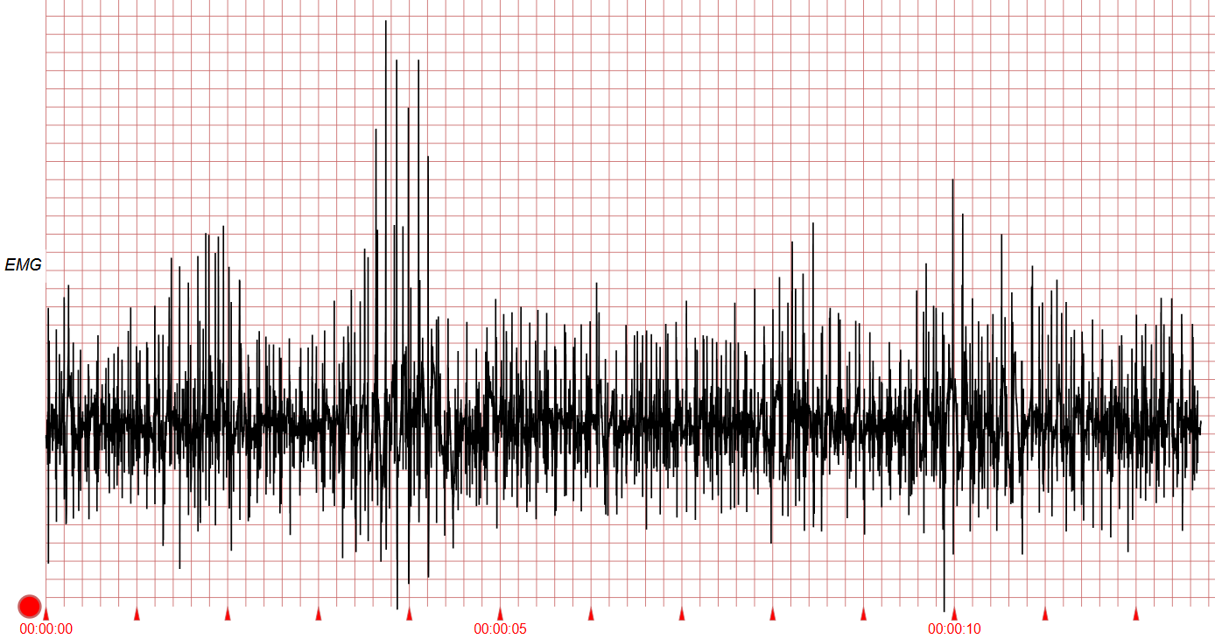
-: Decoding EMG Signals :-
The raw EMG signal is a superimposition of multiple action potentials (APs) of different frequencies and amplitudes generated by nerve communication. These APs are voltage spikes that represent the electrical activity of nerve communication.
The signal is noisy and requires filtering and feature extraction to isolate relevant information. The patterns in the APs, Features of the APs and the location where the signal was taken from will determine the corresponding motion that is to be produced.
As force requirement varies, the APs produced to signal that higher force movement will also vary. Usually, high force activities produce APs with much higher frequencies and amplitudes. [5]
Such features are to be extracted so that we can understand the motion that the amputee was intending to perform

Slide 12
8
Where Machine Learning Comes in ?
Traditional Methods :-
Traditional feature extraction relies on manually selecting values like root mean square (RMS), mean absolute value (MAV), and zero crossings. These values, measured over time, reveal patterns in muscle activity related to movement.
Machine Learning :-
Machine learning algorithms, such as convolutional neural networks (CNNs), offer a more efficient approach. CNNs automatically extract features, identify patterns, and predict movement.
Convolutional Neural Networks (CNNs) are specialized deep learning algorithms designed for processing grid-like data, such as images or time-series signals. They are particularly effective in recognizing patterns and features through hierarchical layers.
Key Components:
Convolutional Layers: Apply filters to extract local features.
Pooling Layers: Reduce spatial dimensions while retaining important information.
Fully Connected Layers: Integrate extracted features for classification or regression tasks.
CNNs are widely used in applications like image recognition, signal processing (e.g., EMG), and object detection due to their ability to learn features automatically from raw data.
Current research often focuses on recognizing specific gestures; but with sufficient data, CNNs could potentially predict precise servo motor angles, enabling more complex prosthetic control.

Slide 13
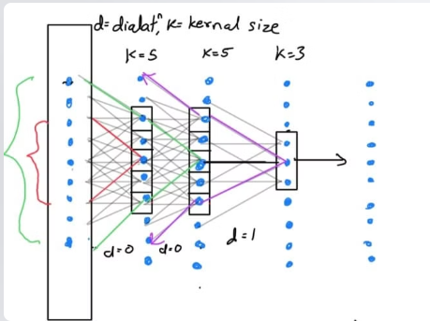
Signal Processing Workflow
Signal Acquisition: EMG signals are captured via electrodes placed on the skin or within muscles.
Preprocessing: Filters remove noise and amplify relevant signals.
Feature Extraction: Characteristics like amplitude, frequency, and duration are computed.
Classification: CNNs analyze features to determine muscle activity patterns.
Detailed Explanation of CNN Layers
Input Layer: Accepts preprocessed EMG signals.
Convolutional Layers:
Use filters to detect patterns such as spikes in EMG signals.
Example: A filter might identify high-frequency components correlating to fast muscle contractions.
Activation Functions: Apply non-linearity to introduce complexity in feature detection. Commonly used functions include ReLU (Rectified Linear Unit).
Pooling Layers: Reduce the spatial size of feature maps to focus on the most important elements.
Fully Connected Layers:
Combine all detected features to classify muscle activity.
Example: "Grip" vs. "Release" action in prosthetics.
Now we have to define few terms such as: Threshold Potential: The voltage level that must be reached to trigger an AP.
Kernel: A matrix used in CNNs to extract features from input data.
Pooling: A down-sampling technique to reduce data size while preserving essential features.
Dilation: Expands the receptive field by skipping certain elements in the input.
Feature Map: The output of convolution layers, representing the presence of specific features in the input data.

Slide 14
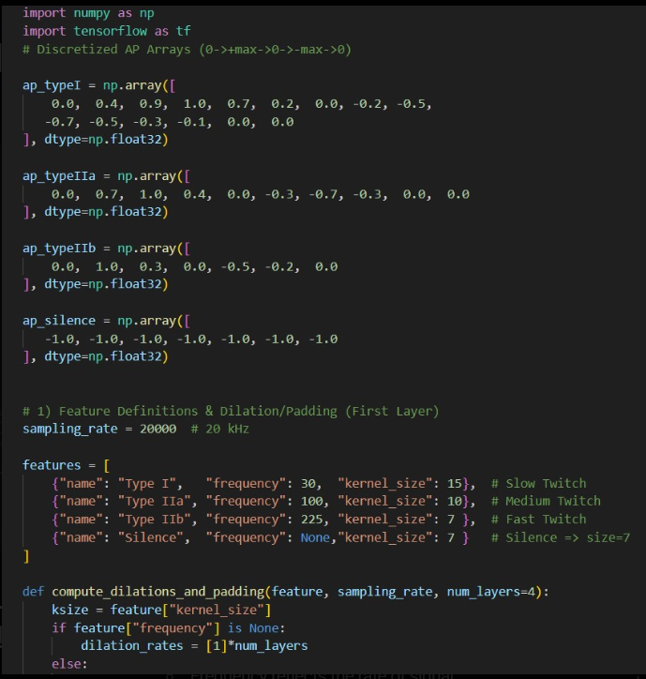
Importing libraries and discretized AP arrays:-
Purpose: The code models different types of Action Potential (AP) patterns for biological signals and processes them in a layered fashion using convolutional techniques.
Libraries:
numpy for numerical operations.
tensorflow for deep learning tasks.
Action Potentials (AP): Arrays represent signal types:
Type I: Slow-twitch fibers.
Type IIa: Medium-twitch fibers.
Type IIb: Fast-twitch fibers.
Silence: Baseline silence signal. These mimic real-world biological signals.
AP Array Shapes: Each array’s size reflects the kernel size of convolution layers that will process these signals.
Data Type: Defined as float32 for compatibility with TensorFlow operations.

Slide 15
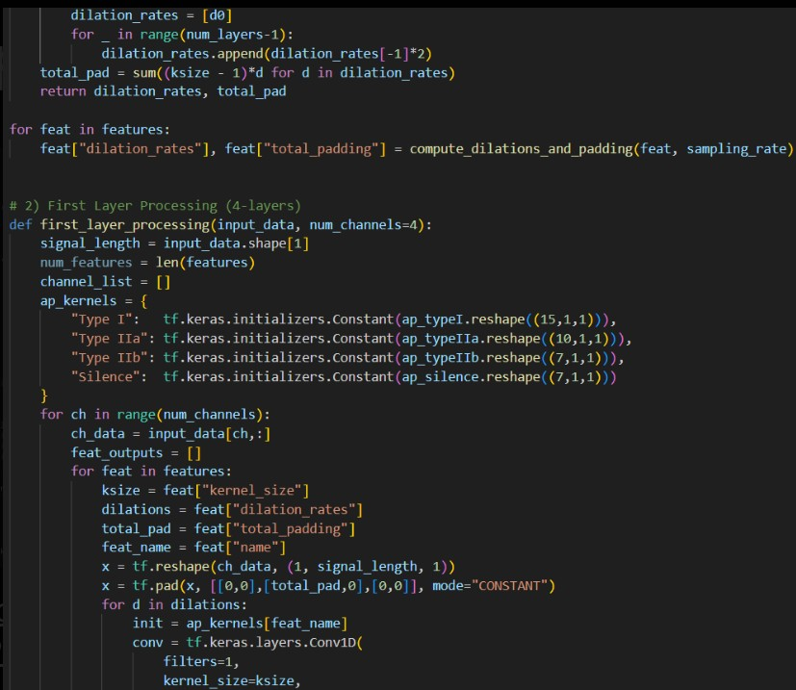
Feature Definitions and Dilation/padding:
Features: Defined for each AP type with frequency and kernel size.
Frequency reflects the rate of signal repetition.
Kernel size defines the window of signal processed in each step.
Sampling Rate: Signals are sampled at 20,000 Hz (20 kHz), simulating high-resolution biological data.
Dilations: A method to expand the effective receptive field of the convolution without increasing kernel size, calculated dynamically based on signal frequency.
Padding: Ensures the input signal retains its dimensions during processing. Total padding is determined based on kernel size and dilation rates.
Dynamic Calculation: For each feature, dilation rates and padding are precomputed for efficient processing.

Slide 16
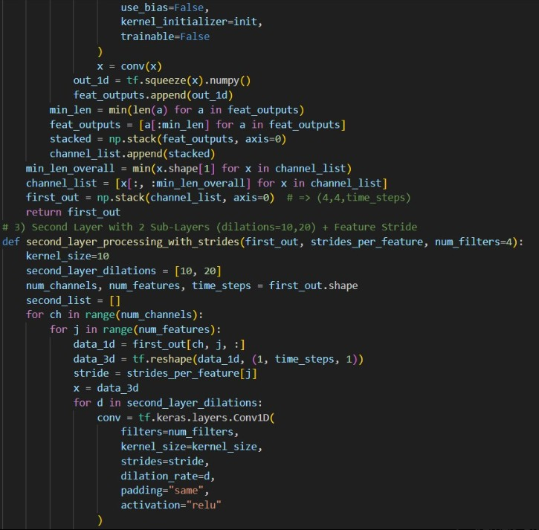
First Layer Processing :-
Purpose: Initial processing of raw input signals across multiple channels (4 channels in this example).
Input Shape: Signals are reshaped and padded for convolution.
Kernels: Predefined AP arrays serve as fixed kernels for convolution, simulating signal-specific filters.
4-Layer Convolution:
Each layer applies a convolution with increasing dilation rates.
This progressively extracts features at different scales.
Feature Stacking: Outputs from different features (AP types) are aligned and stacked, ensuring all features have the same length for further processing.

Slide 17
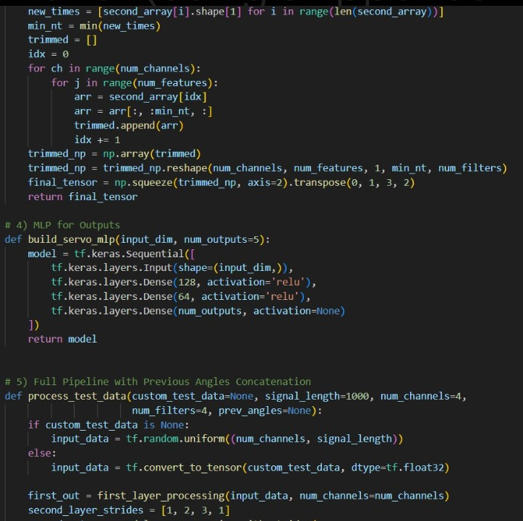
Second layer Processing with strides :-
Second Layer: Enhances extracted features using dilations and strides. - Strides: Downsample the signal to focus on dominant features. - Dilations: Set to 10 and 20, capturing long-range dependencies in signals.
2. Multiple Filters: Each convolution in this layer produces multiple filters (default: 4 filters).
3. 3D to 2D Transformation: Outputs are reshaped and aligned across channels and features.
Output Shape: (Channels × Features × Time Steps × Filters), enabling further processing in higher layers.

Slide 18
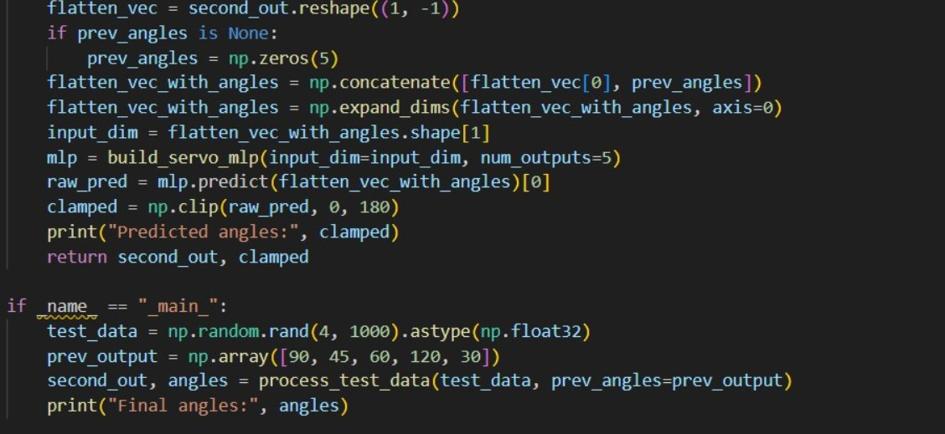
Multi layer Perceptron and Full pipeline of the code:
MLP (Multi-Layer Perceptron): - Converts extracted features into servo control angles. - Uses three dense layers for feature reduction and mapping to outputs.
1. Previous Angles: Concatenates previous servo angles with the processed signal features to add temporal continuity.
2. Predictions: MLP predicts raw angles for servos, clamped to the range [0, 180] degrees.
3. Pipeline Workflow: - Input signals → First Layer → Second Layer → Flattened Features → MLP → Predicted Angles.
4. Testing and Example Usage: Random test signals simulate input data. Predefined servo angles allow testing the continuity of predictions.
5. Output: The predicted servo angles, representing processed signal control, are printed for interpretation.
To enhance the model's ability to interpret APs from the EMG signals, we have predefined a set of specialized kernels in the first convolutional layer. These kernels are tailored to detect APs within specific frequency ranges, ensuring efficient feature extraction from the raw EMG data.
We will employ the freeze-unfreeze training methodology for optimal performance. Initially, the predefined kernels will remain fixed, and we will train only the second convolutional layer along with the Multi-Layer Perceptron (MLP). Once this phase is complete, we will unfreeze the kernels in the first layer and proceed to fine-tune the entire model. This approach ensures that the predefined kernels are both effective at their intended task and adaptable to the dataset, ultimately leading to a more accurate and robust CNN.

Slide 19
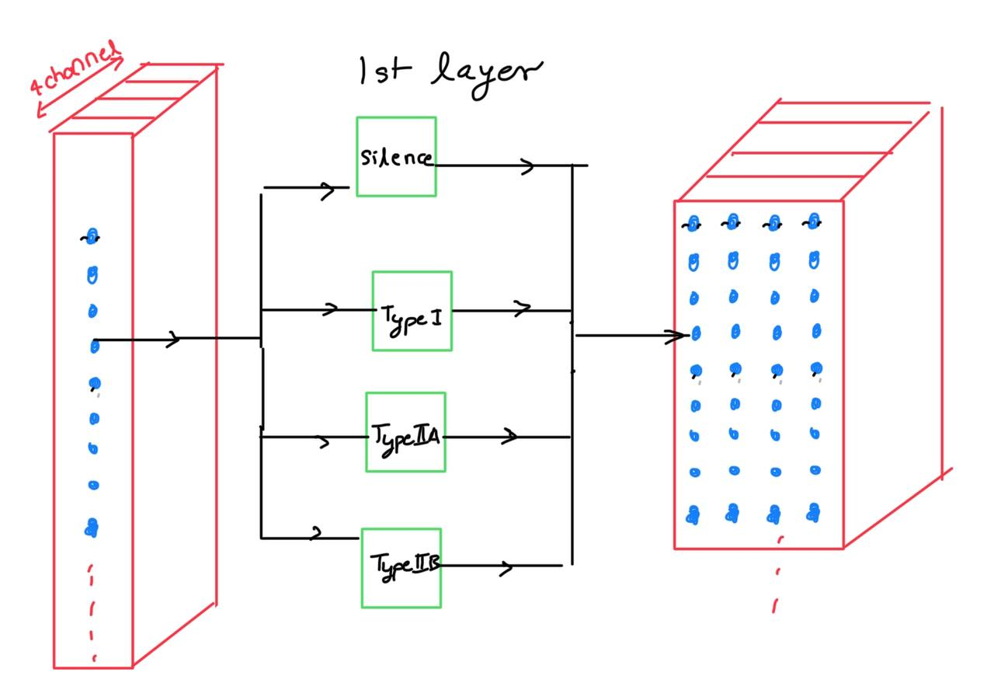
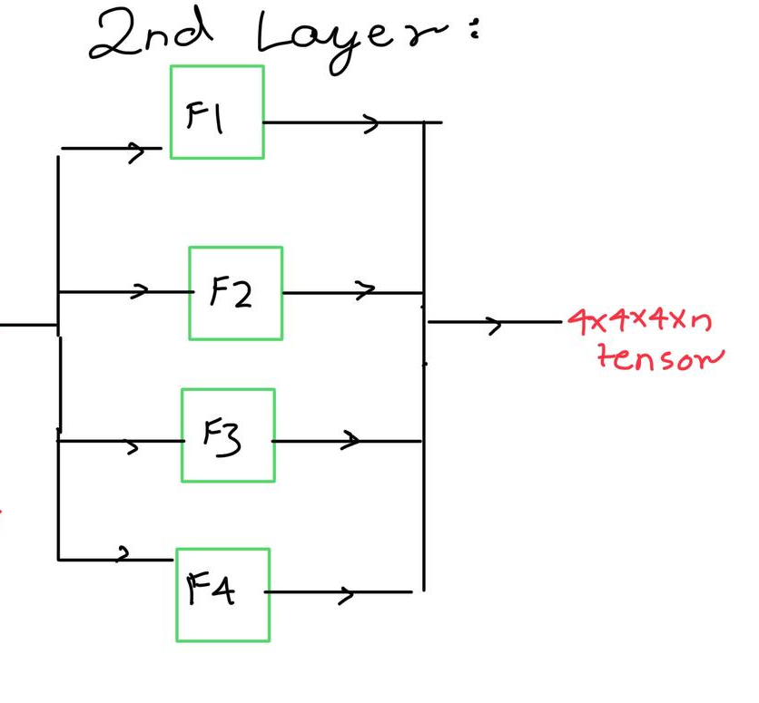
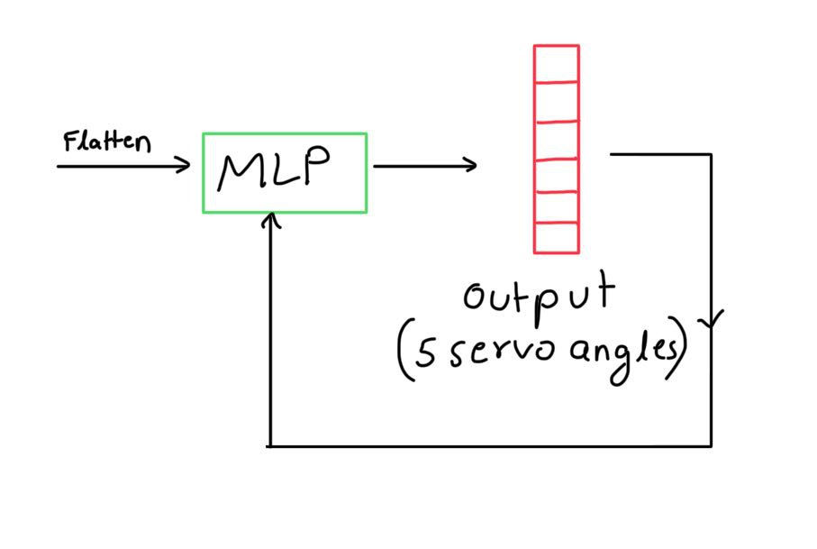
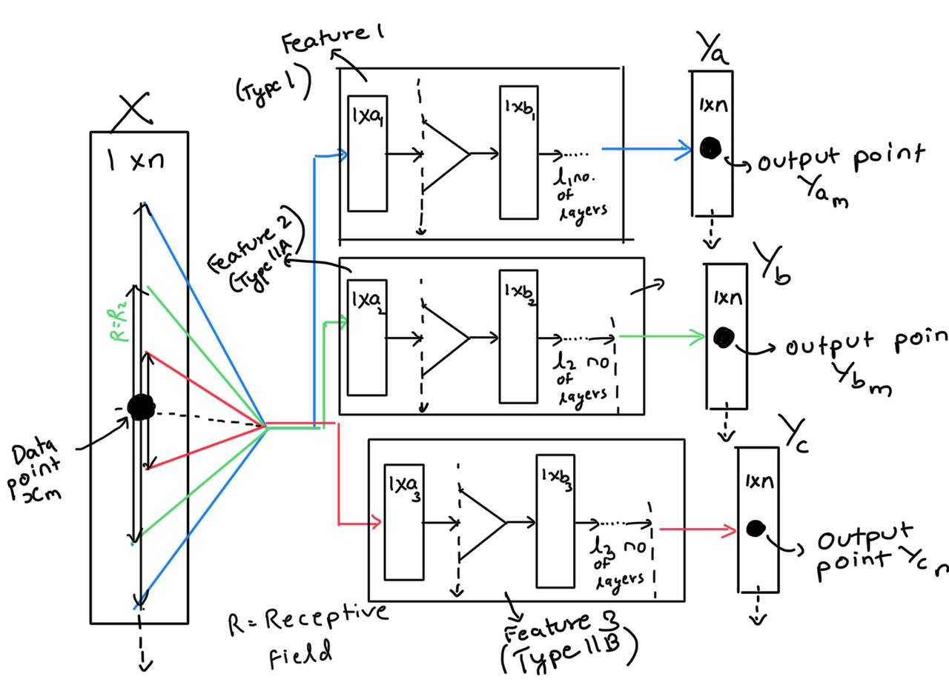
1D Temporal CNN - Architecture Overview :-
INPUT :- ( Raw EMG Data )
1st Layer - Detects APs of different freq ranges
2nd Layer - Recognises patterns in the APs
Complete 1D Temporal CNN Model for EMG Processing
Detailed View of Layer 1 – Action Potential Detection in the CNN Model
MLP - Servo Angle Prediction
Output :- ( Servo Motor Angles )

Slide 20
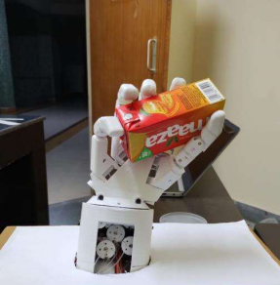
Conclusion :-
Impact
Combining ML and EMG enables real-time, intuitive prosthetic control. The system adapts to individual users while remaining affordable.
Real time control with cost effectiveness
Gripping various objects (e.g., spheres, rectangles) to test strength and flexibility.
Future Work
Collect and analyze EMG data. Modify and Test the model for other prosthetic limbs
Addition of feedback mechanisms such as FSRs to detect slipping while holding objects, and prevent it.
Addition of Haptic feedback
Reduction of computational load on inbuilt electronics by connecting the prosthetic to a mobile phone to perform complex computation without needing powerful microprocessors
Validation Setup (Gripping Various Objects for Strength & Precision Testing)

Slide 21
References
[1] Mohammadi, A., Lavranos, J., Zhou, H., Mutlu, R., Alici, G., Tan, Y., Choong, P. and Oetomo, D., 2020. A practical 3D-printed soft robotic prosthetic hand with multi-articulating capabilities. PloS one, 15(5), pp.e0232766.
[2] Gentile, C. and Gruppioni, E., 2023. A perspective on prosthetic hands control: From the brain to the hand. Prosthesis, 5(4), pp.1184-1205.
[3] Pradhan, A., He, J. and Jiang, N., 2022. Multi-day dataset of forearm and wrist electromyogram for hand gesture recognition and biometrics. Scientific data, 9(1), pp.733.
[4] Mongardi, A., Rossi, F., Prestia, A., Ros, P.M., Roch, M.R., Martina, M. and Demarchi, D., 2022. Hand gestures recognition for human-machine interfaces: A low-power bio-inspired armband. IEEE Transactions on Biomedical Circuits and Systems, 16(6), pp.1348-1365.
[5] https://info.tmsi.com/blog/what-is-emg, 29/1/2025, 5:44pm
[6] Phienthrakul, T., 2018, January. Armband gesture recognition on electromyography signal for virtual control. In 2018 10th International Conference on Knowledge and Smart Technology (KST) (pp. 149-153). IEEE.
[7] Woźniak, M., Pomykalski, P., Sielski, D., Grudzień, K., Paluch, N. and Chaniecki, Z., 2018, September. Exploring EMG gesture recognition-interactive armband for audio playback control. In 2018 Federated Conference on Computer Science and Information Systems (FedCSIS) (pp. 919-923). IEEE.
[8] Amor, A.B.H., El Ghoul, O. and Jemni, M., 2019, December. Sign language handshape recognition using Myo Armband. In 2019 7th International conference on ICT & Accessibility (ICTA) (pp. 1-5). IEEE.
[9] Kim, S., Kim, J., Ahn, S. and Kim, Y., 2018. Finger language recognition based on ensemble artificial neural network learning using armband EMG sensors. Technology and Health Care, 26(S1), pp.249-258.

Slide 22
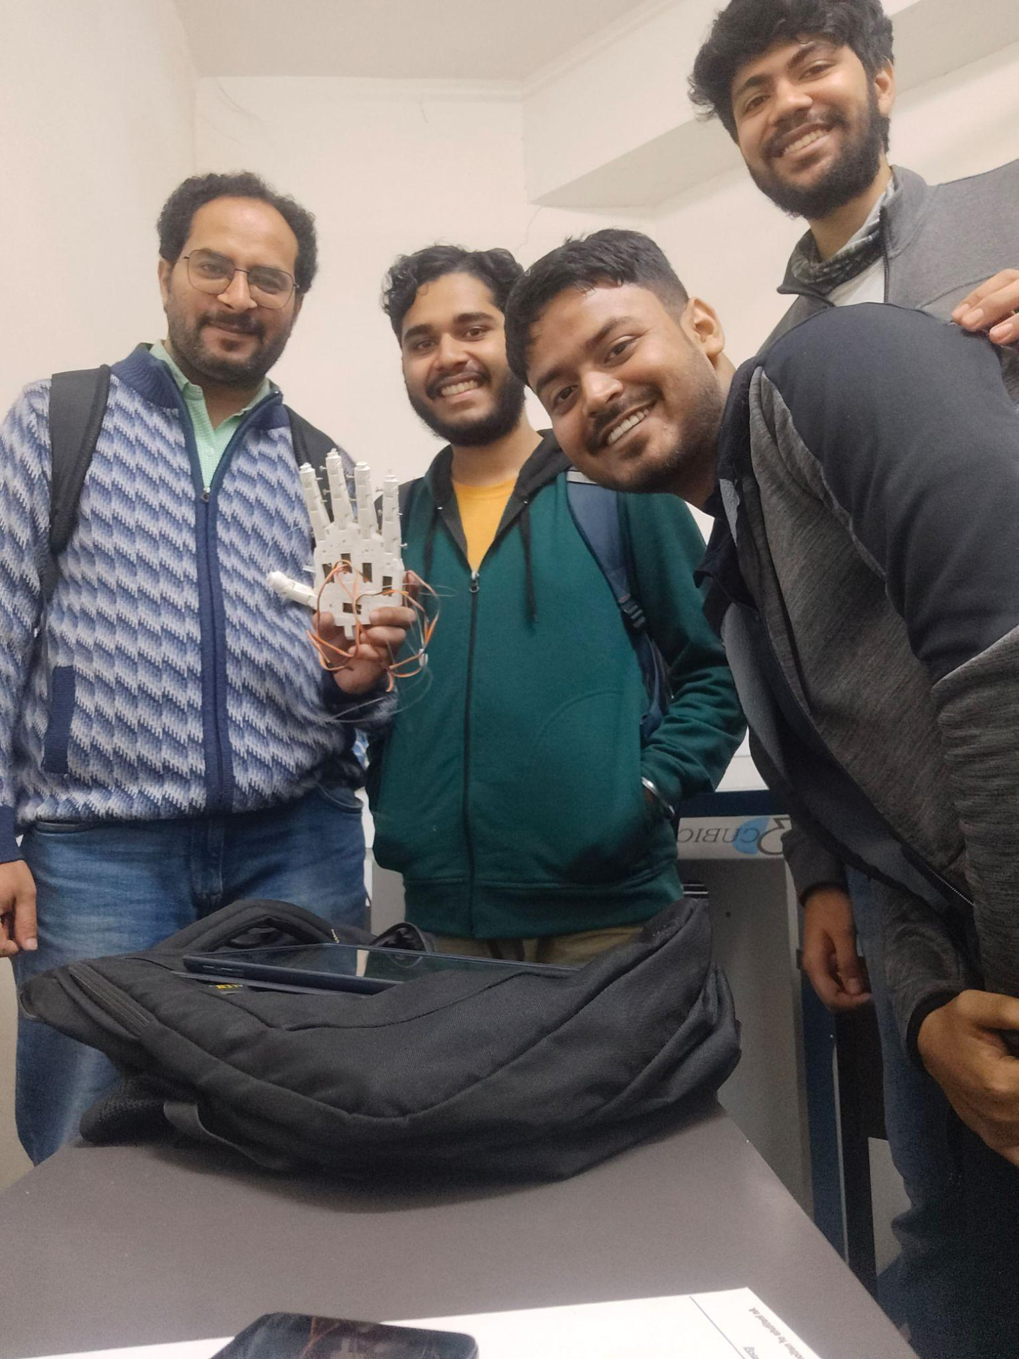
Left to Right :-
Prof Prasoon Kumar
Kushanavo Rakshit
Swagato Chakraborty
Aditya Joshi
Thank
You

